Slide 1
IT8703 Applied Machine Learning
- CA 1 Titanic Report
Data Analysis Prediction of Titanic datasets
Lum Kok Keong (P7320307)
NSDAI2 Class 2 (Thursday)

Slide 2
Agenda
Introduction
I - Exploratory data analysis
II - Feature engineering
III - Modeling
IV - Hyperparameters tuning
V - Saving the trained Model
VI - Submission of test data and results
VII - Summary

Slide 3
Introduction

Slide 4
Introduction
Reference of Titanic datasets
In this assignment, a total of 2 datasets Titanic.csv & test.csv were selected and downloaded from Polymall. The Survived column is the target variable. If Survived = 1 the passenger survived, otherwise he's dead and while the other variables describe the passengers are the features.
The is the variable we're going to predict is Survived
References resources used as follow :
  1. https://ahmedbesbes.com/how-to-score-08134-in-titanic-kaggle-challenge.html
  2. https://www.analyticsvidhya.com/blog/2016/01/complete-tutorial-learn-data-science-python-scratch-2/
  3. http://PacktLib.PacktPub.com - eBook Learning scikit-learn: Machine Learning in Python by Raúl Garreta & Guillermo Moncecchi

Slide 5
Introduction
Data Analysis Prediction Process
We will be using 6 different stages as follow :
  Exploratory data analysis
  Feature engineering
  Modeling
  Hyperparameters tuning
  Saving the trained Model
  Submission of test data and results
The scikit, csv, numpy, matplotlib, preprocessing, pickle, tree,ensemble, linear_model, model selection, metrics are used for this assignment
8 algorithms with 2 different features sets are used to evaluate the dataset:
  Logistic Regression
  Random Forest Classifier
  Decision Tree Classifier (CART)
  Gradient Boosting Classifier
  Random Forest Regressor
  Support Vector Machine
  Kneighbors Classifier
  Dummy Classifier

Slide 6
I - Exploratory data analysis

Slide 7
Titanic train data statistics (1/10)
Dataset Description

Slide 8
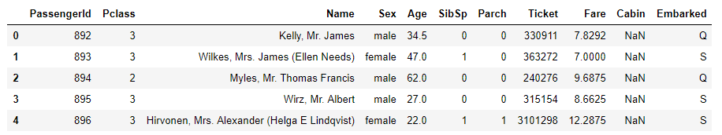
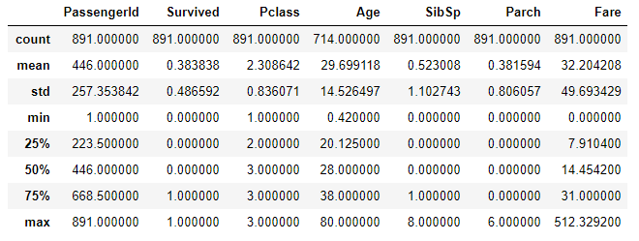
Titanic train data statistics (2/10)
Simple Text Based Statistic analysis using Pandas
The following output uses the pandas library to load train.csv for the first 5 rows
The dataset has 12 columns, 891 rows Summary of the descriptive Statistic are presented.

Slide 9
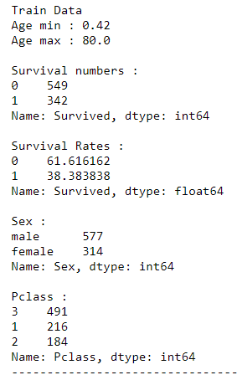
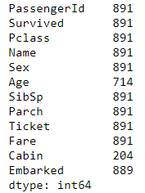
Titanic train data statistics (3/10)
Dataset Details
Survived is the target to be predicted
The count variable shows that 177 values are missing in the Age column, Cabin has 687 missing and Embarked has 2 missing
Survival rates data ratio are ~ 6:4 hence data is not skewed
Sex ratio ~ 6.4:3.6 which is considered not so skewed
Pclass has higher weightage on the 2nd class

Slide 10
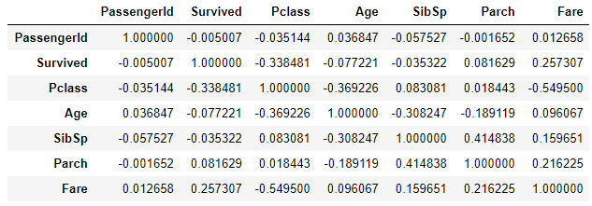
Titanic train data statistics (4/10)
Features Correlations
Seems like Pclass & Fare has the highest negative correlation.
It is follow by Parch & SibSp positive correlation which both are relationship definition and
Age & Pclass with negative correlation

Slide 11
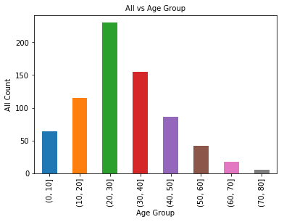
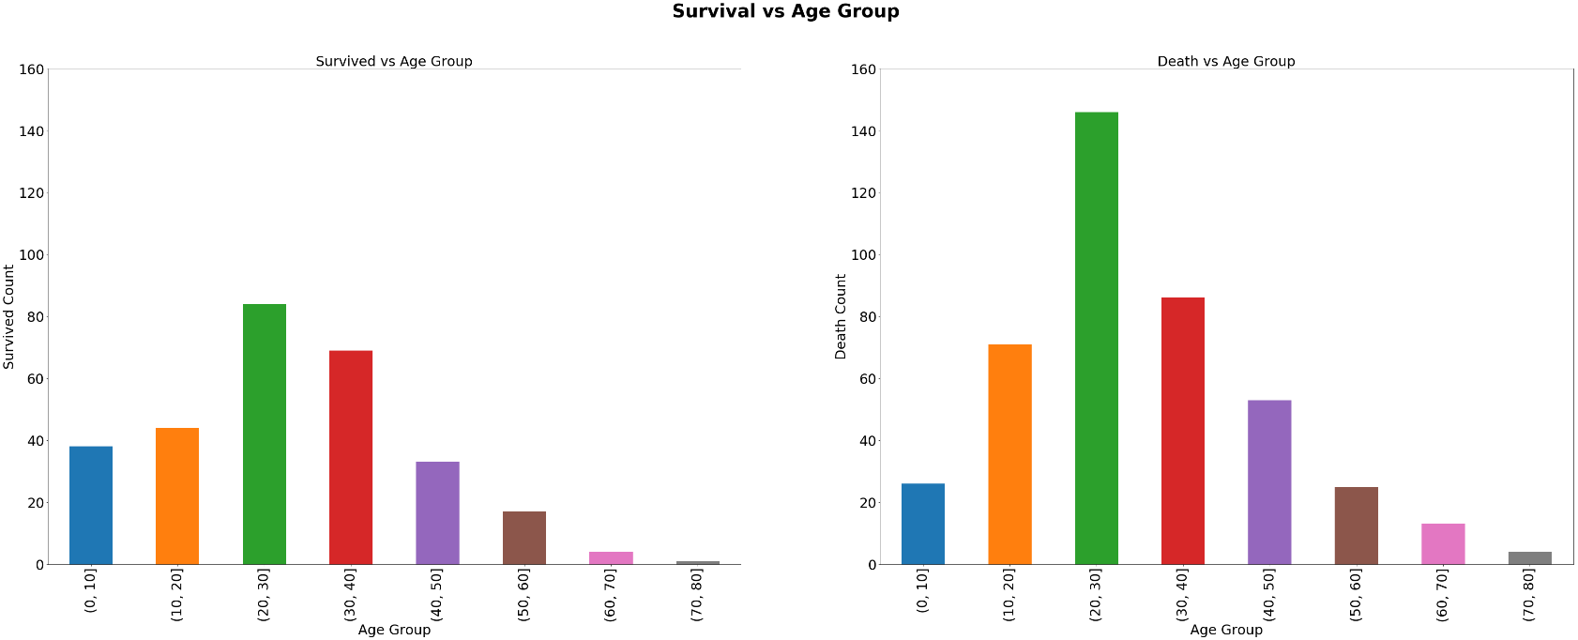
Titanic train data statistics (5/10)
Analysing in details for feature Age survival rate
Observations:
Since there is too many age numbers to represent in plot, we will use age category in terms of 10 years and add a new feature column onto the titanic_df bins = 0, 10, 20, 30 , 40, 50, 60 ,70 ,80
As can see from above bar charts that the age group seems like to have similar pattern which implies that all age group are with well proportionally survival rate
Hence Age may not be a big weightage as a feature.

Slide 12
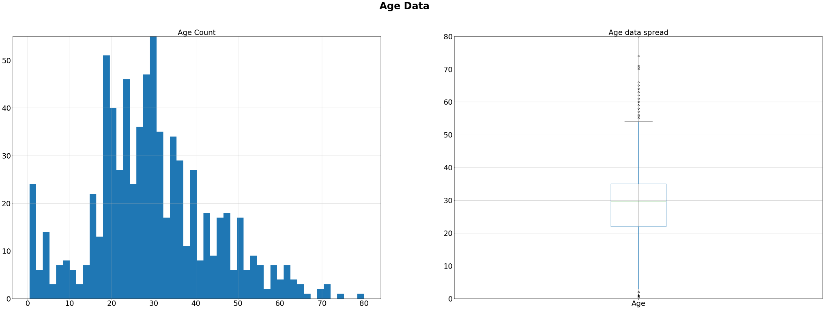
Titanic train data statistics (6/10)
Checking on Age data spread and Normality
Observations:
The histogram looks normal while the boxplot shows some outliers data

Slide 13
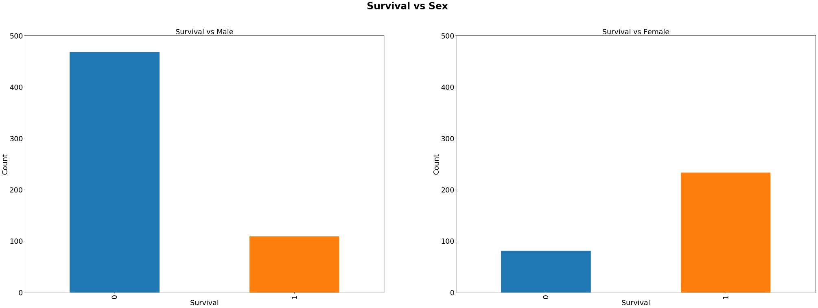
Titanic train data statistics (7/10)
Analysing in details for feature Sex survival rate
Observations:
Male has a lower survival rate

Slide 14
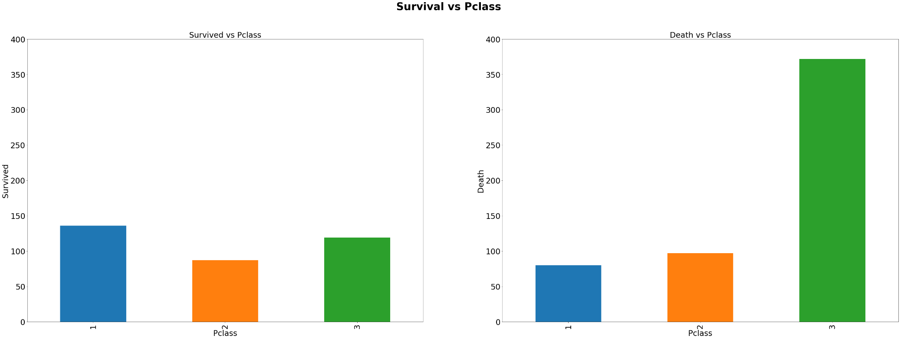
Titanic train data statistics (8/10)
Analysing in details for feature Pclass survival rate
Observations:
Pclass 1 has the highest survival rate while Pclass 3 has the lowest

Slide 15
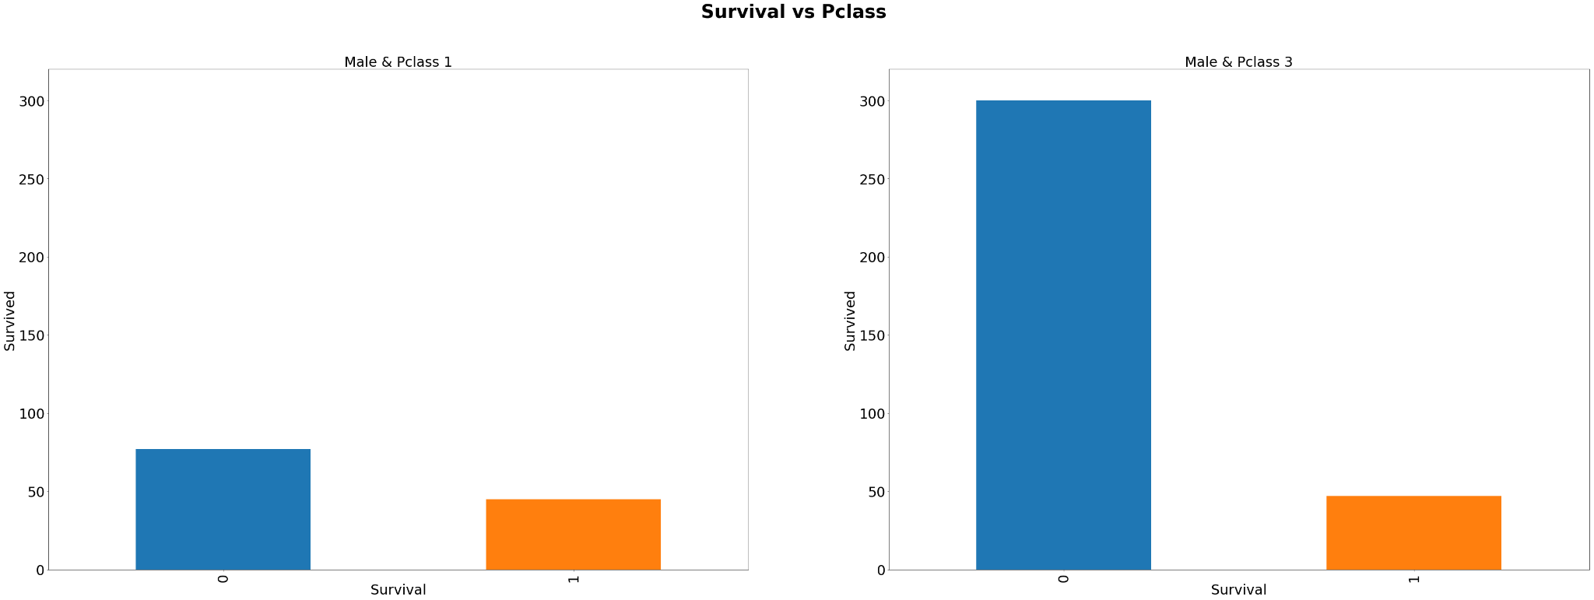
Titanic train data statistics (9/10)
Analysing in details for combined feature Pclass & Sex survival rate
Observations:
Seems like more Male in Pclass 3 has highest non survival rate

Slide 16
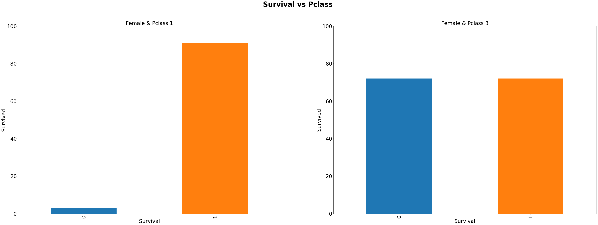
Titanic train data statistics (10/10)
Analysing in details for combined feature Pclass & Sex survival rate
Observations:
Seems like more Female in Pclass 1 has highest survival rate and 50% survival rate in Pclass 3
It looks like male passengers are more likely to succumb.
The Sex variable seems to be a discriminative feature. Women are more likely to survive

Slide 17
II - Feature engineering

Slide 18
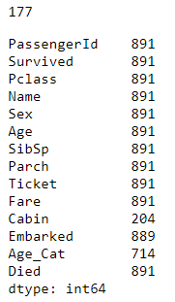
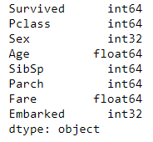
Feature Engineering (1/2)
Processing missing Data
Age variable was missing 177 values. This is a large number. Simply replacing them with the mean age
Embarked variable has missing 2 values. This is a small number. Simply replacing them with the mode age
Since Cabin has large numbers of missing values, in both train and test data set , we will drop this column. As PassengerId, Name and Ticket Number will not make sense as a affecting factor to the survival rate
Passenger is just an ID and similar to the name. Ticket Number does not means anything as the Pclass has already differentiate the passengers already
Final Features to be used for the prediction test

Slide 19
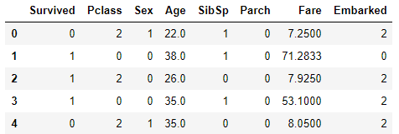
Feature Engineering (2/2)
Label encoding for category data
Since, sklearn requires all inputs to be numeric, we should convert all our categorical variables into numeric by encoding the categories. Before
that we will fill all the missing values in the dataset.

Slide 20
II - Modeling

Slide 21
Modeling (1/6)
Importing the require modules for the modeling
Next, we will import the required modules. Then we will define a generic classification function, which takes a model as input and determines the Accuracy and Cross-Validation scores.
Import models from scikit learn module:
  from sklearn.linear_model import LogisticRegression
  from sklearn.model_selection import KFold #For K-fold cross validation
  from sklearn.ensemble import RandomForestClassifier
  from sklearn.tree import DecisionTreeClassifier, export_graphviz
  from sklearn.ensemble.gradient_boosting import GradientBoostingClassifier
  from sklearn.ensemble import RandomForestRegressor
  from sklearn import linear_model
  from sklearn import metrics
  from sklearn.metrics import f1_score
  from sklearn.model_selection import cross_val_score
  from sklearn.metrics import roc_curve, auc
  from sklearn.metrics import confusion_matrix

Slide 22
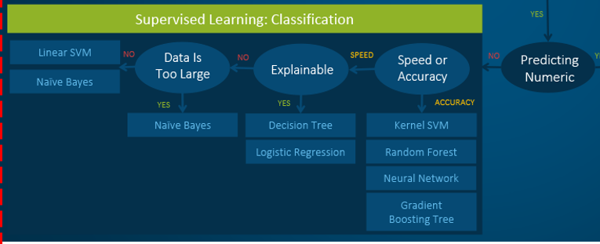
Modeling (2/6)
Algorithm Selection

Slide 23
Modeling (3/6)
Testing of features selection
Two set of different number of features will used for the test on all the 5 algorithms
  ['Pclass','Sex','Age','SibSp','Parch','Fare','Embarked']
  ['Pclass','Sex','Age','Fare',]
These 2 sets are selected is due to that for the 7 features test results shows that the top 4 features weightage are the Pclass, Sex, Age and Fare. This set of test is to see if the other 3 is redundant.
Dummy Classifier is used as the baseline for comparison
7 different algorithm are used for comparison to see which can offer the best perofmance results as follow:
    Logistic Regression
    Random Forest Classifier
    Decision Tree Classifier (CART)
    Gradient Boosting Classifier
    Random Forest Regressor
    Support Vector Machine
    Kneighbors Classifier
From the test result in the next slide, it shows that Random Forest Classifier using the 7 features has the most suitable scores, hence it is selected as the final algorithm for the prediction
A 10-fold cross-validation using Kfold test harness is used to demonstrate each metric

Slide 24
Modeling (4/6)
Testing results

Slide 25
Modeling (5/6)
Selecting the Algorithm (1/2)
Classification accuracy is the number of correct predictions made as a ratio of all predictions made. It is really only suitable when there are an equal number of observations in each class (which is rarely the case). Hence this will have lesser weight in the performance evaluation
AUC represents a model’s ability to discriminate between positive and negative classes. ROC can be broken down into sensitivity and specificity. A binary classification problem is really a trade-off between sensitivity and specificity. So for Titanic case which is predicting life or death chances if uses on some other cruises boarding, for eg., Hence this is a more important criteria to use as a performance gauge
The confusion matrix is a handy presentation of the accuracy of a model with two or more classes. As it shows the cells of the table are the number of predictions made by a machine learning algorithm. Hence it is important to to use especially the recall performance measure is important with life and death matters, rather wrong predicting death than life.
The R^2 (or R Squared) or Coefficient of Determination metric provides an indication of the goodness of fit of a set of predictions to the actual values.
Number Kfold split used 5 & 10 for comparison

Slide 26
Modeling (6/6)
Selecting the Algorithm (2/2)
Generally both Random Forest & Decision Tree Classifier algorithm has share the same high score compare to the rest.
Classification accuracy – Random Forest & Decision Tree Classifier has the highest score
AUC – Both Random Forest & Decision Tree Classifier has the same score
The confusion matrix – Both Random Forest & Decision Tree Classifier has the similiar score
Coefficient of Determination - Decision Tree Classifier is just a 0.01 better than Random Forest Classifier.
Kfold = 10 – Since there is very little difference between Kfold split 5 & 10, will use the default 10.
In conclusion both are comparable , and either one will able to . For learning purpose and time factor, I have selected Random Forest Classifier and learn how to fine tune the hyper parameters of it as describe in details in the hyper parameter tuning section
Using the Dummy Classifier as reference, the final selection of Random Forest Classifier has a large margin performance even compare to the other 5 algorithm except for Decision Tree classifier which share similar performance results. Base on all the Performance metric results attained, I am confidence it will yield high probability of prediction

Slide 27
IV - Hyperparameters tuning

Slide 28
Hyperparameters tuning (1/5)
Random Forest Classifier parameters
outcome = 'Survived'
predictors = ['Pclass','Sex','Age','SibSp','Parch','Fare','Embarked']
n_range = range(49,54)
max_depth_range = range(12,22)
parameter_grid = {
'max_depth' : max_depth_range,
'n_estimators':n_range ,
'max_features': ['sqrt', 'auto', 'log2'],
'min_samples_split': [2],
'min_samples_leaf': [1],
'bootstrap': [True, False],
}
forest = RandomForestClassifier()
cross_validation = StratifiedKFold(n_splits=5)
grid_search = GridSearchCV(forest,
scoring='accuracy',
param_grid=parameter_grid,
cv=cross_validation,
verbose=1,
n_jobs=-1
)
grid_search.fit(titanic_df[predictors], titanic_df[outcome])
model = grid_search
parameters = grid_search.best_params_
As reference to the Modeling test results that Random Forest Classifier with all the 7 features shows the best highest performance, hence we will be using a Random Forest model for the Hyperparameters # tuning
Importing using the following modules for the tuning :
  from sklearn.model_selection import StratifiedKFold
  from sklearn.model_selection import GridSearchCV
With GridSearchCV, we can specify a grid of any number of parameters and parameter values to traverse. It will train the classifier for each combination and obtain a cross-validation accuracy to evaluate each one.

Slide 29
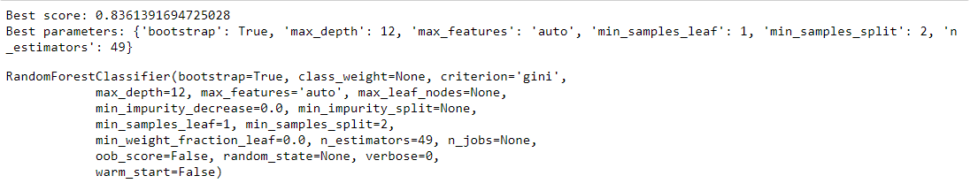
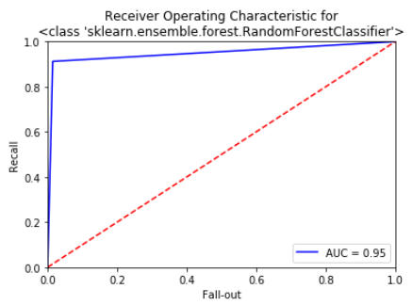
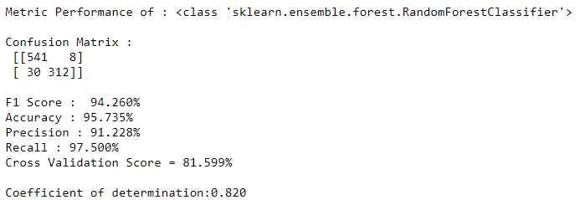
Hyperparameters tuning (2/5)
GridSearchGV results

Slide 30
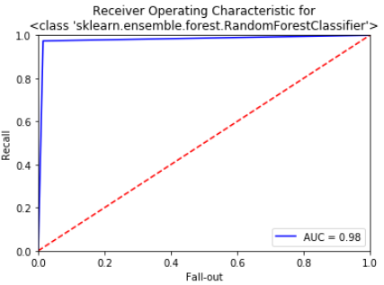
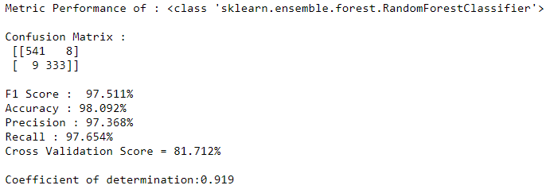
Hyperparameters tuning (3/5)
Fine Tuning
Observations:
As reference to the previous default Random Forest Classifier test results , it has achieved higher than the GridSearch test results, hence I decided to retest on the 5 parameters for fine tuning : (The final numbers are the one be used for the final model)
  max_depth=21,
  n_estimators=49,
  min_samples_split=2,
  min_samples_leaf=1,
  max_features='log2
Results as a shown on the right side achieve the highest possible results after few iteration of test among the 5 parameters.

Slide 31
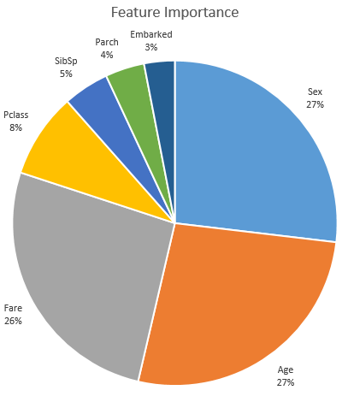
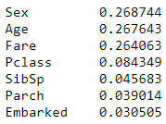
Hyperparameters tuning (4/5)
Features Importance (1/2)
Observations:
After the fine tuning the features importance weightage is as shown on the right for Random Forest Classifier using Fold split of 10
Generally, comparing to all the algorithms tested, all share the same top 4 features weightage as follows (For some the order may not be the same but most are):
  Sex
  Age
  Fare
  Pclass

Slide 32
Hyperparameters tuning (5/5)
Features Importance (2/2)
Observations:
Generally, comparing to all the algorithms tested, all share the same top 4 features weightage as follows (For some the order may not be the same but most are):
  Sex
  Age
  Fare
  Pclass

Slide 33
V - Saving the trained Model

Slide 34
Saving the trained Model (1/2)
Saved the model using pickle & Visualising of the tree
# Visualising the Tree , only max_depth = 5 is used due to visual effect
from sklearn.ensemble import RandomForestClassifier
clf = RandomForestClassifier(max_depth=5,
n_estimators=49,
min_samples_split=2,
min_samples_leaf=1,
max_features='log2')
clf = clf.fit(titanic_df[predictors],titanic_df[outcome])
estimator_nonlimited = clf.estimators_[7]
from sklearn import tree
from sklearn.tree import export_graphviz
export_graphviz(estimator_nonlimited, out_file='tree_limited_to_5.dot', feature_names = titanic_df[predictors].columns,
class_names = outcome,
rounded = True, proportion = False, precision = 2, filled = True)
!dot -Tpng tree_limited_to_5.dot -o tree_limited_to_5.png -Gdpi=600
from IPython.display import Image
Image(filename = 'tree_limited_to_5.png')
# We can save the trained model clf using pickle
import pickle
model = RandomForestClassifier(max_depth=21,
n_estimators=49,
min_samples_split=2,
min_samples_leaf=1,
max_features='log2')
predictors = ['Pclass','Sex','Age','SibSp','Parch','Fare','Embarked']
outcome = 'Survived'
model.fit(titanic_df[predictors],titanic_df[outcome])
s = pickle.dumps(model)
pickle.dump( model, open( "Titanic_trained_model.p", "wb" ) )
model2 = pickle.load( open( "Titanic_trained_model.p", "rb" ) )
# Alternatively, we can save the trained model clf with sklearn joblib
from sklearn.externals import joblib
joblib.dump(model, 'Titanic_trained_model.pkl')
model3 = joblib.load('Titanic_trained_model.pkl')

Slide 35
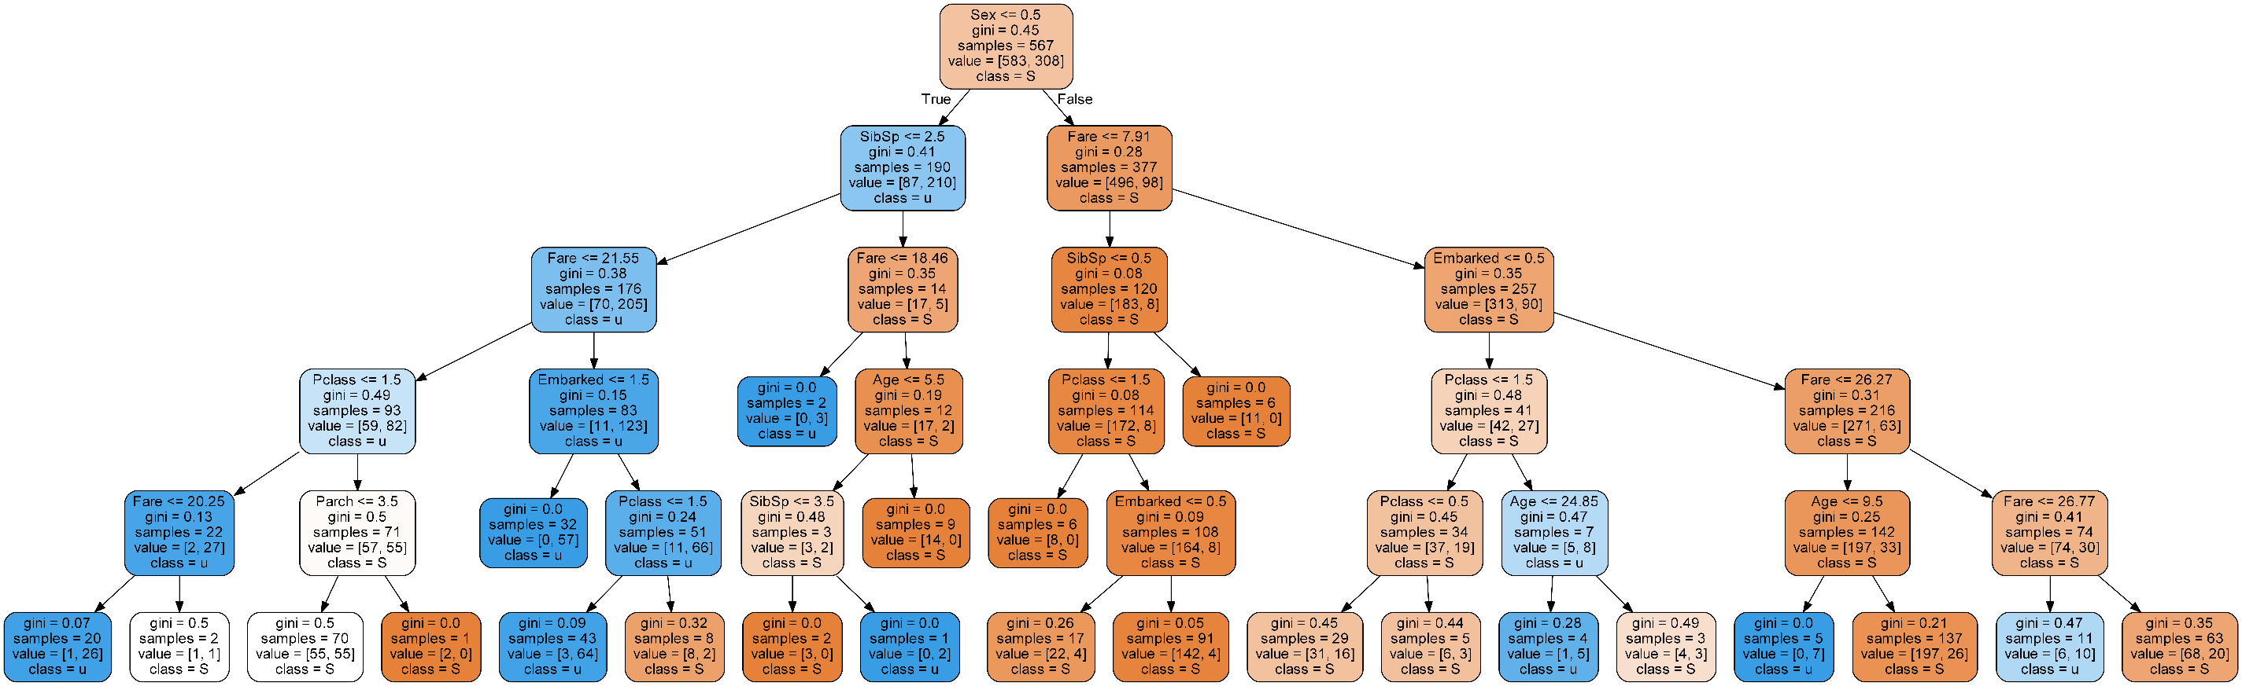
Saving the trained Model (2/2)
Random Forest Classifier Tree Visualisation (depth = 5 for feasible demonstration)

Slide 36
VI - Submission of test data and results

Slide 37
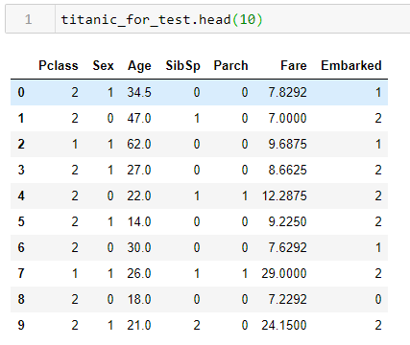
Submission of test data and results (1/2)
Simple Text Based analysis using Pandas
Same missing data, feature selection and label encoding process are applied to the test data .
# Load the classifier model
import pickle
final_model = pickle.load( open( "Titanic_trained_model.p", "rb" ) )
# Now run on test data
# Make predictions on test set:
predictions = final_model.predict(titanic_for_test)
titanic_test['PassengerId'] = pd.DataFrame(titanic_test['PassengerId'])
titanic_test['Survived'] = predictions

Slide 38
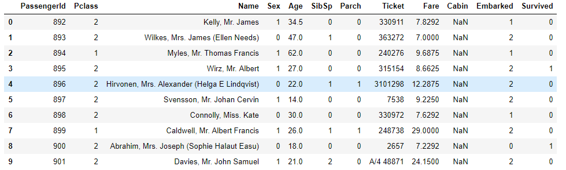
Submission of test data and results (2/2)
Save test results to excel file format
import csv
# Create a new excel workbook
writer = pd.ExcelWriter('Lum Kok Keong P7320307 - Titanic_test_predictions.xlsx', engine='xlsxwriter')
titanic_test.to_excel(writer, sheet_name='Titanic Test Results')
# Close the Pandas Excel writer and output the Excel file.
writer.save()

Slide 39
Summary
Both Male & Female from Pclass 1 has a higher survival rate while Female has much higher survival rate than Male
Male in Pclass 3 has highest non survival rate
The most top 3 influence features are the Sex, Age and Fare as indicated by the Random Forest Classifier algorithm weightage

Slide 40
Thank You

